Slide 1
1.3 Compression
Show understanding of the need for and examples of the use of compression
Show understanding of lossy and lossless compression and justify the use of a method in a given situation
Show understanding of how a text file, bitmap image, vector graphic and sound file can be compressed

Slide 2
Today
Show understanding of the need for and examples of the use of compression
Show understanding of lossy and lossless compression and justify the use of a method in a given situation
Show understanding of how a text file, bitmap image, vector graphic and sound file can be compressed
Understand: What is compression?
Able: Apply different compression methods
Answer: When to use lossy and when to use lossless?

Slide 3
What is compression?
Make things take up less space
Many methods of compression
All of them are either lossy or lossless

Slide 4
Lossy
Remove redundant data
Creates smaller file size
Worse quality

Slide 5
Where is lossy compression used?
Lossy is used when you can afford to remove data
Sound
Images
Video

Slide 6
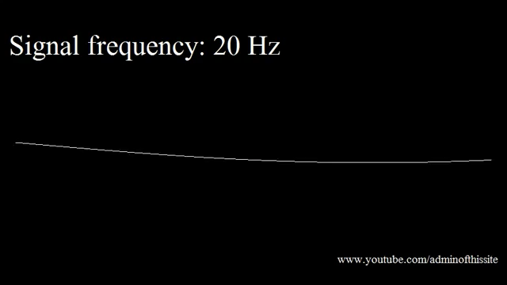
Lossy Sound – MP3
Sound
Your stupid human ears can hear sounds from 20Hz to 20,000Hz
But as you get older, you lose the ability to hear. So there is no point having frequencies inside your sound file that ‘most’ humans cannot hear.
Test your hearing, it is playing, I can start hearing it around 120Hz. It lasts for around 2 minutes.

Slide 7


Lossy Image
Your stupid human eyes cannot see all the colours and shades of colour that could be in an image. It also cannot tell fine detail. Which one of these is lossy?

Slide 8
Lossy Image
ORIGINAL
LOSSY

Slide 9
ORIGINAL
LOSSY

Slide 10
Lossy Image
Okay, so you cannot see the difference between original and lossy image unless you zoom in…. But even though my example of the guitar girl is fine, I don’t want to lie to you.
The original image was a JPEG image.
You’ve all seen JPEG images, but JPEG images have already been compressed.
A real, 100%, pure image, with nothing removed is called a RAW image.
A JPEG image takes a RAW image, looks at the the data your stupid human eyes cannot see (or cannot see well) and removes it

Slide 11
RAW vs JPEG
You see the sky in JPEG, looks rubbish…. But this image is also a lie, because if you did a lot of lossy compression then yes the sky could look like this but no one would do this.

Slide 12
RAW vs JPEG

Slide 13
RAW vs JPEG
So, with this guy, why does the RAW file look duller?
Because RAW has all the information. It kept everything. It means it includes all the light data AND the dark data.
RAW usually looks worse to our human eyes because we are used to JPEG. So why do we use RAW? We use it because we want to have 100% of the data and when we use photoshop we can play with 100% of the data

Slide 14
Video - Lossy
Now a video is just one picture shown after another after another after another, so the compression is the same.
(Okay, this is a lie, there are 3 ways that a video does compression…but its not on your syllabus, but I’ll add to the end of this PPT)

Slide 15
Lossless
Keeps 100% of the information
Less free space than lossy after compression
Better quality

Slide 16
Where you use lossless?
You use lossless wherever you must keep all of the data.
Text
Vector**
Vector images don’t have compression, because it’s built on math and coordinates, you don’t need to compress it. The quality will always be the same regardless of the size
There are many types of lossless compression:
Run Length Encoding
Huffman (not in syllabus)

Slide 17
Run length encoding
Is lossless
CCCCCCCCCCWCCCCCCCCCCPPP
Can be written as
10C 1W 10C 3P
But we don’t write the spaces as this takes space ))
10C1W10C3P

Slide 18
Run Length Encoding
You can even use RLE for images too.
Look at the top line,
You could say: White, White, White, White, White, White, White, White
Or just say W,W,W,W,W,W,W,W,
Or with RLE just say 8W
Line 2 would be: 1W 2B 1W 2B 2W
Or you can be smarter and say: 2 WBB 2W

Slide 19
Task
Draw a 8x8 grid
Shade in an image
Give to someone
They have to do the RLE on it

Slide 20
EXTRA FREE INFO
These next two topics are NOT in your syllabus, but are pretty cool and not so difficult.
We have:
Lossless Compression : Huffman
And
How are videos compressed

Slide 21
Huffman Coding
It’s a way to compress text.
Lossless

Slide 22
ASCII
In ASCII, every letter is either 7 bits for standard ASCII, but really everyone uses extended ASCII so we say every ASCII letter is 8 bits.
Batman’s real name is Bruce Wayne
This sentence in Binary is:
01000010 01100001 01110100 01101101 01100001 01101110 11100010 10000000 10011001 01110011 00100000 01110010 01100101 01100001 01101100 00100000 01101110 01100001 01101101 01100101 00100000 01101001 01110011 00100000 01000010 01110010 01110101 01100011 01100101 00100000 01010111 01100001 01111001 01101110 01100101
We want to make this smaller

Slide 23
How many times
Well what if we just count the number of times a letter happens (we actually also count spaces and punctuation too)

Slide 24
How many times
Letter | Frequency
a | 5
[SPACE] | 5
e | 4
n | 3
B | 2
m | 2
s | 2
r | 2
t | 1
‘ | 1
l | 1
i | 1
u | 1
c | 1
W | 1
y | 1
Batman’s real name is Bruce Wayne
So instead of using 8 bits for each letter, why don’t we say the most popular letters only uses 1 bit Then the next most popular use two bits…and so on
a = 0
[SPACE] = 1 e = 00
And there is a problem, does 00 = e or does 00 = ‘a’ twice

Slide 25
Huffman
Letter | Frequency
a | 5
[SPACE] | 5
e | 4
n | 3
B | 2
m | 2
s | 2
r | 2
t | 1
‘ | 1
l | 1
i | 1
u | 1
c | 1
W | 1
y | 1
One smart way to solve this is with Huffman encoding
You still need the frequency.
We will use this frequency to build a Binary tree,
A Huffman Tree

Slide 26
Build a tree
Letter | Frequency
a | 5
[SPACE] | 5
e | 4
n | 3
B | 2
m | 2
s | 2
r | 2
t | 1
‘ | 1
l | 1
i | 1
u | 1
c | 1
W | 1
y | 1
Take the two most least used characters
W and y
We say how many times they are used. 1 time each
W
y
1
1
W
y

Slide 27
Build a tree
Letter | Frequency
a | 5
[SPACE] | 5
e | 4
n | 3
B | 2
m | 2
s | 2
r | 2
t | 1
‘ | 1
l | 1
i | 1
u | 1
c | 1
W | 1
y | 1
Then we link these two by adding their values
Now take this and put it at the bottom of your tree
2
1
1
W
y

Slide 28
Build a tree
Letter | Frequency
a | 5
[SPACE] | 5
e | 4
n | 3
B | 2
m | 2
s | 2
r | 2
t | 1
‘ | 1
l | 1
i | 1
u | 1
c | 1
W | 1
y | 1
Then we link these two by adding their values
Now take this and put it in back in your frequency table.
2
1
1
W
y

Slide 29
Build a tree
Letter | Frequency
a | 5
[SPACE] | 5
e | 4
n | 3
B | 2
m | 2
s | 2
r | 2
2 | 1
t | 1
‘ | 1
l | 1
i | 1
u | 1
c | 1
W | 1
y | 1
Now take this and put it in back in your frequency table.
If you reach a letter (like ‘r’) that matches the sum of two frequencies (W and y) then put them all on one level
2
1
1
W
y

Slide 30
My Tree
This is what it looks like so far.
Then you just keep repeating it
2
1
1
W
y

Slide 31
START
22
11
12
10
7
8
5
5
a
SPACE
4
4
4
4
e
4
3
n
2
2
2
2
2
r
r
s
2
2
2
2
B
m
1
1
1
W
y
u
1
1
1
c
l
i
1
1
1
1
l
i
t
‘

Slide 32
So what
Now with the tree, every time you go left is a 0
Every time you go right is a 1
START
22
11
12
10
7
8
5
5
a
SPACE
e
4
4
4
4
4
3
n
2
2
2
2
2
r
r
s
2
2
2
2
B
m
1
1
1
W
y
u
1
1
1
c
l
i
1
1
1
1
l
i
t
‘

Slide 33
What’s the code?
START
So if you want ‘B’
It was 01000010
You know the frequency is 2.
You know left is 0
Right is 1
So from the top (START)
Go Right (22) - 1
Go Right (12) - 1
Go Right (8) - 1
Go Right (4) - 1
Go Left (2) - 0
So B is now 11110
22
11
12
10
7
8
a
5
SPACE
5
4
4
4
4
e
4
3
n
2
2
r
2
2
2
r
s
2
2
2
2
B
m
1
1
1
W
y
u
1
1
1
c
l
i
1
1
1
1
l
i
t
‘

Slide 34
What’s the code?
B is now 11110
What if you want a more popular letter, ‘e’
START
RIGHT (22) – 1
RIGHT (12) - 1
RIGHT (8) - 1
LEFT (e) - 0
So e is now 1110
Because e is more popular than B, it has a shorter code
START
22
11
12
10
7
8
5
5
a
SPACE
e
4
4
4
4
4
3
n
2
2
2
2
2
r
r
s
2
2
2
2
B
m
1
1
1
W
y
u
1
1
1
c
l
i
1
1
1
1
l
i
t
‘

Slide 35
+ & -
+ More popular letters use less binary bits
Takes time to make a Huffman Tree
You have to store the tree so there is a reference
± If you have a really deep/tall tree, you may have a letter that uses more than 8 bits. But this is okay because that letter will be at the bottom of the tree and those letters are not used often

Slide 36
Today
Understand : What is a video?
Able : Explain encoding
Answer : What is frame rate

Slide 37
What is a video?
What is the correct definition?
Video is a series of moving images played back at speed to imitate movement
Video is a series of moving images
Video is a series of still images
Video is a series of still images that are play backed at speed to imitate movement

Slide 38
Frames
If video is a set of images play backed at speed. How quick must it be?
Frame – This means one image.
If you have 1 image on screen for 1 second, you say your video is 1 frame per second (fps)
Most videos are 30fps and smooth videos or video games are done at 60fps.
Higher frame rate the smoother the video playback

Slide 39
Encoding
There are two main ways that a video gets displayed.
Interlaced encoding
Progressive encoding

Slide 40
Interlaced
It shows an image in two frames
Splits image into rows
Displays the odd number rows in the first frame
Then displays even number rows in the second
Happens so quick you think it’s a single frame

Slide 41
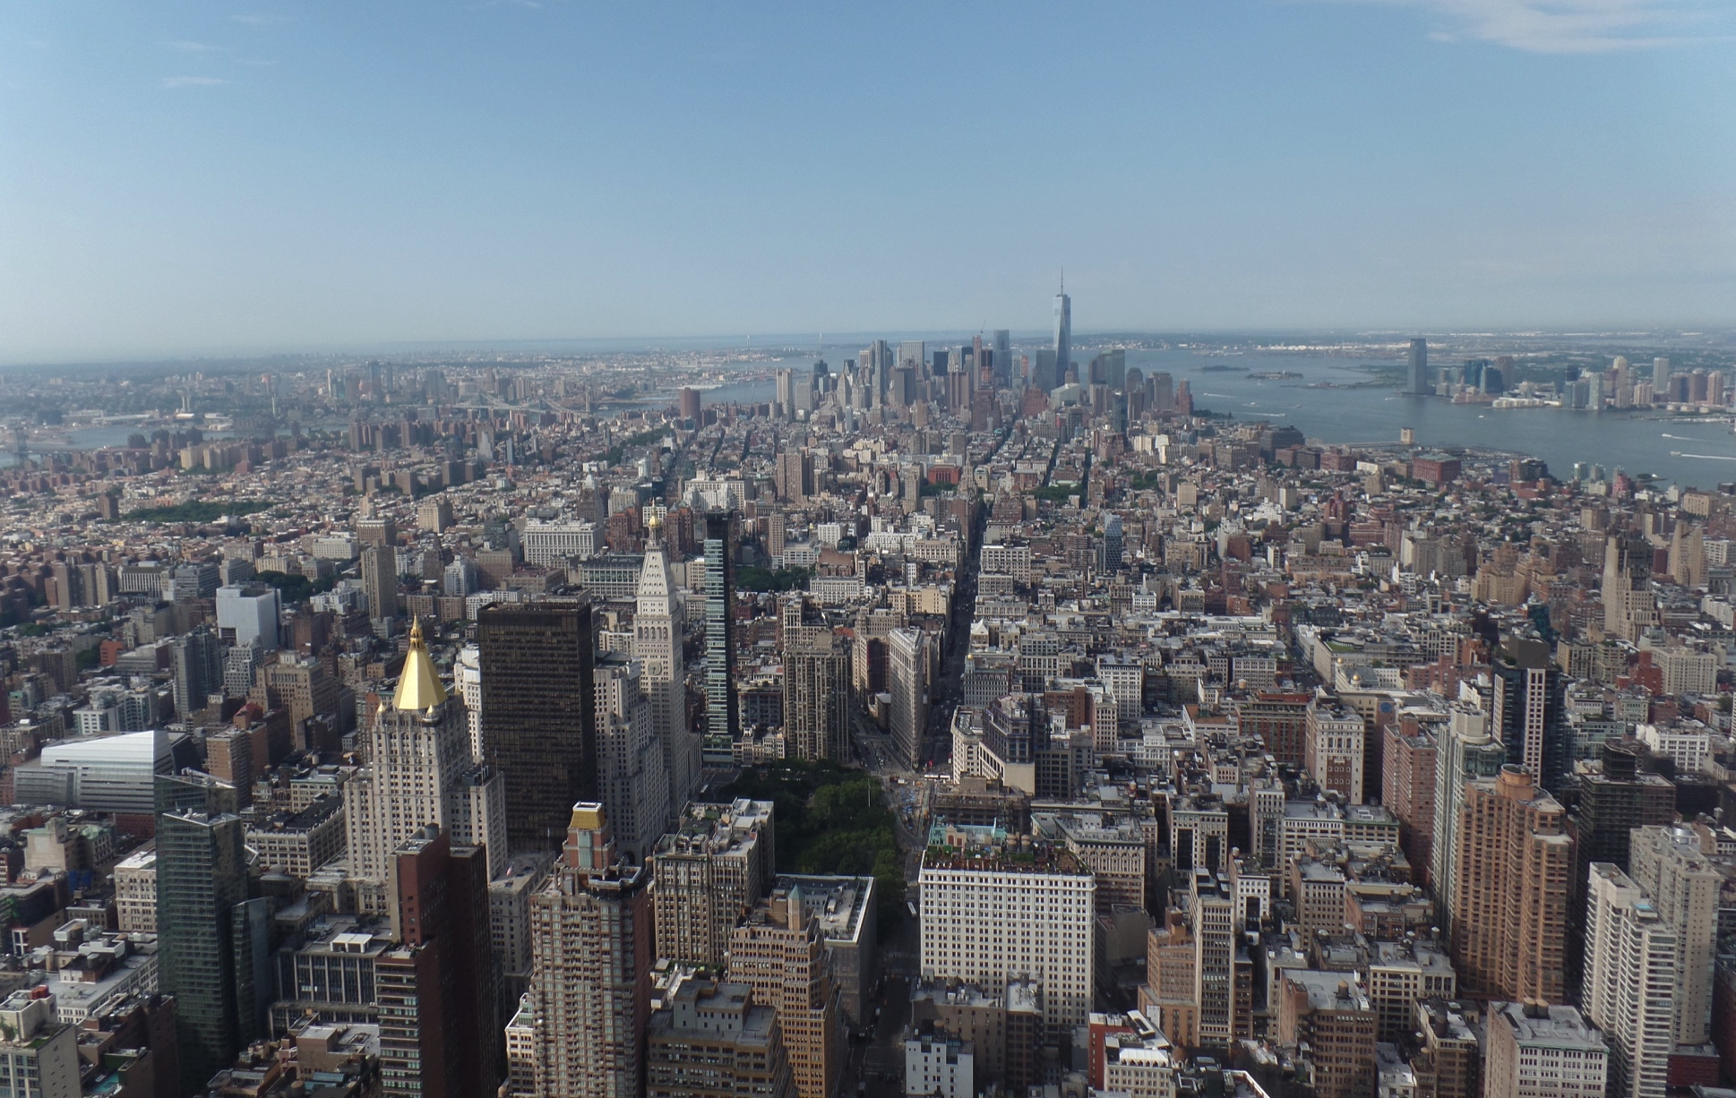
Interlaced – Takes a frame

Slide 42
Interlaced – Splits it

Slide 43
First frame– Displays odd sections

Slide 44
Second frame– Displays even sections

Slide 45
Interlaced

Slide 46
Why?
Cheaper on bandwidth to send part of a frame then the whole frame
Older technology (before progressive)
Broadcast TV uses interlaced – because its cheaper (both hardware is cheaper and bandwidth cost)

Slide 47
Progressive
Displays whole frame at once

Slide 48
Progressive

Slide 49
Why?
Better quality – less ‘noise’ / artifacts than interlaced
Hardware has gotten better

Slide 50
Find out what are:
Image artifacts
Moiré effect

Slide 51
Today
Understand : What is interframe compression
Able : Understand the difference between Spatial and temporal redundancy
Answer : Why we use compression

Slide 52
Interframe Compression
Videos are big sizes
So you need to compress the video to make it smaller
But how??

Slide 53
Interframe compression - i-frame
It starts with an i-frame
An i frame is your full frame – it must be the first frame in your video and you can have many i-frames in your video

Slide 54
Interframe – P Frame
The next frame of your video is broken up into 8x8 blocks called MACRO BLOCKS
If the Macro block from frame 2 is the same or similar as frame 1 then we will put in a P-frame (predicted frame)
A P frame looks at an i-frame and says “you look almost the same” instead of processing the whole thing I’ll just process the changes”
This includes colour changes, size, movement

Slide 55
Interframe – B Frame
An I-frame is fixed,
A P frame looks at an i-frame
A B frame (bidirectional) looks at both an i-frame and p frame

Slide 56
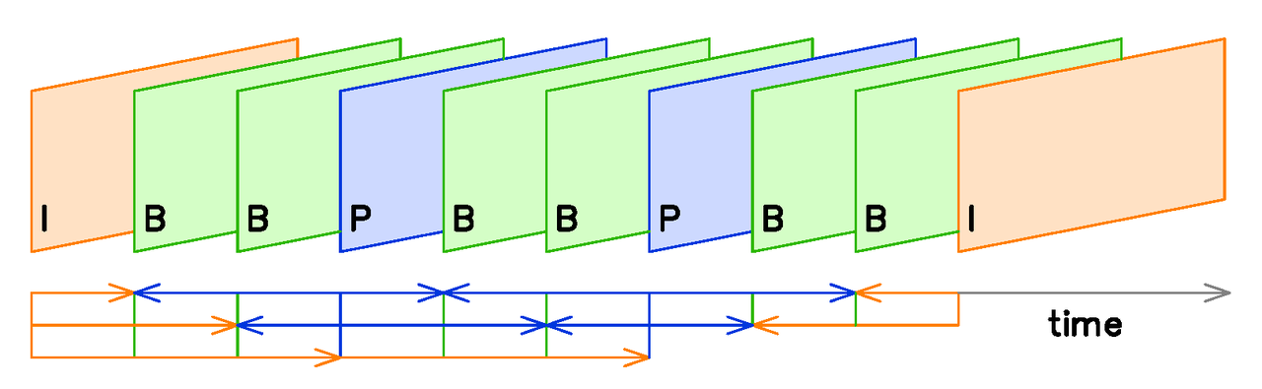
The format of it IBBPBBPBBI

Slide 57
Spatial Redundancy
Just like when you compress an image (like a JPEG)
It only happens on a single frame (usually i-frames)
It looks at your frame and removes data that you cannot see / notice the difference (much)

Slide 58
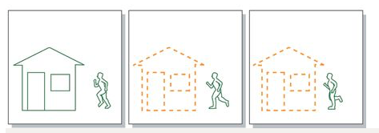
Temporal Redundancy
If parts of your video don’t change then an instruction is given to say “hey, don’t change this part”
So in this example the house doesn't’t change.
It is used in P-frames
They use half as much data as an i-frame

